Slide 1
Image Processing and Pattern Recognition (IPPR):
(Lecture 8)

Slide 2
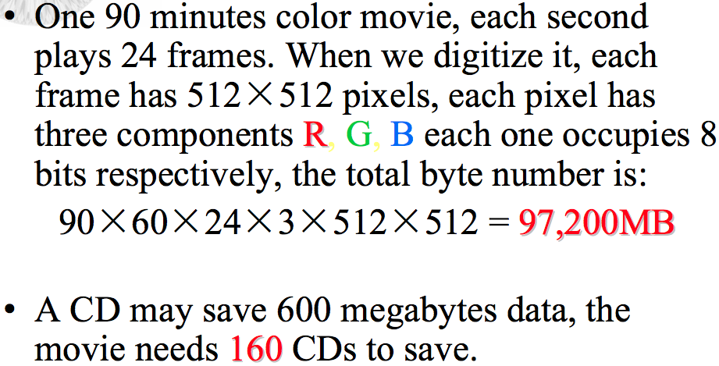
Why we need image compression?

Slide 3
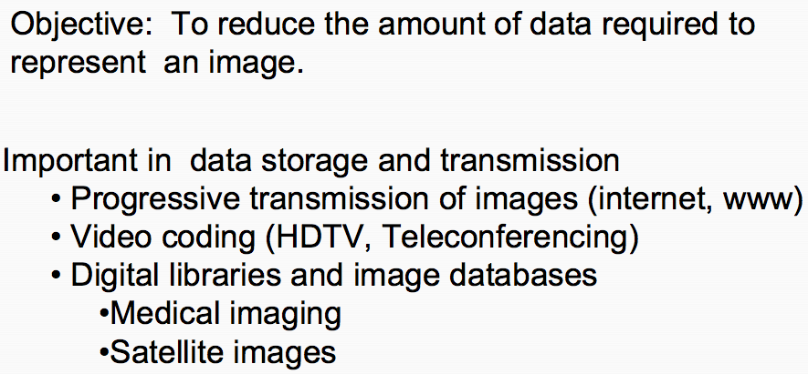
Image Compression

Slide 4
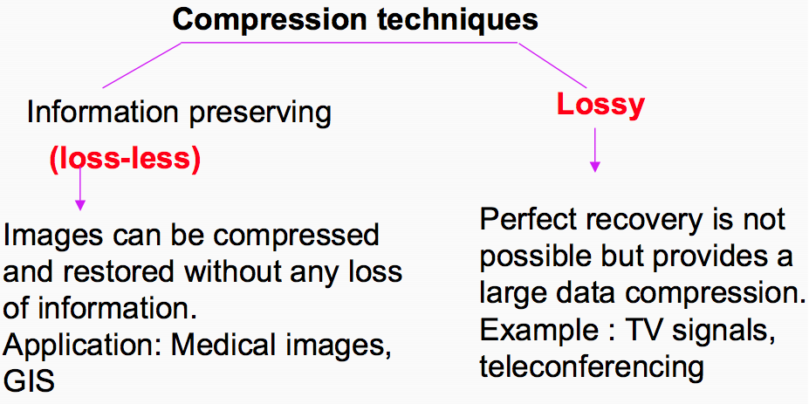
Lossy Vs. Lossless Compression

Slide 5
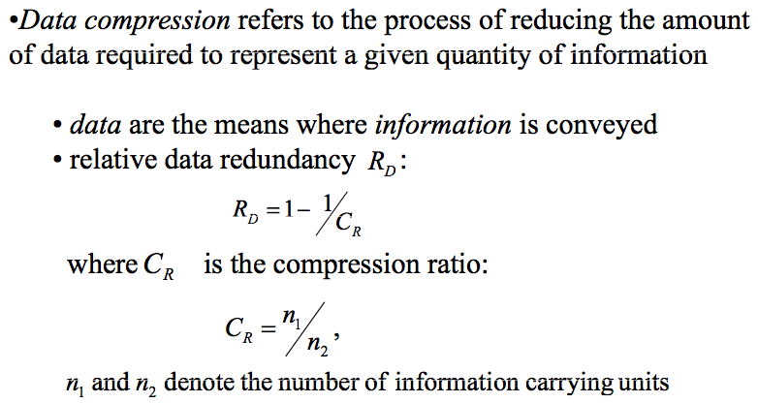
Image Compression

Slide 6
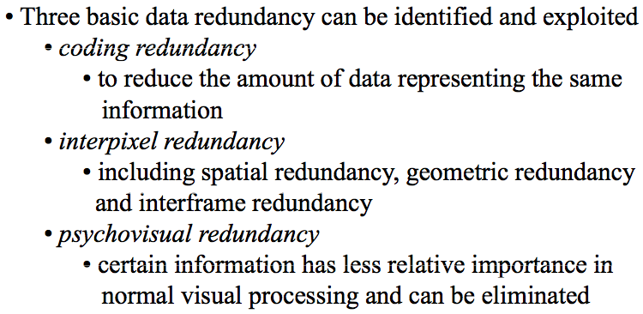
Image Compression

Slide 7
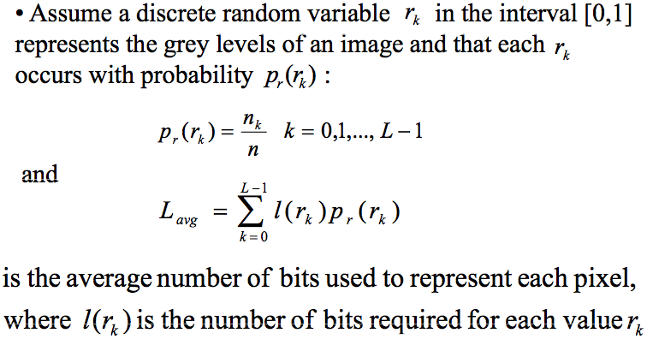
Coding Redundancy

Slide 8
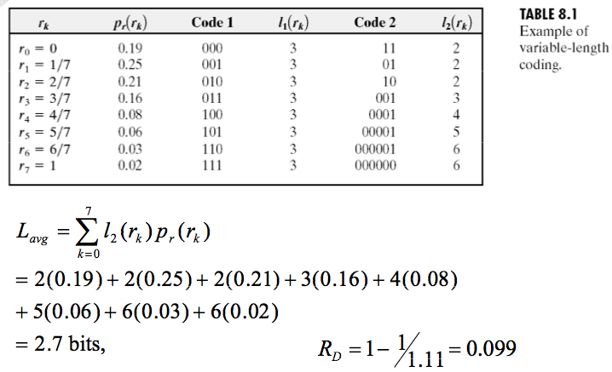
Coding Redundancy

Slide 9
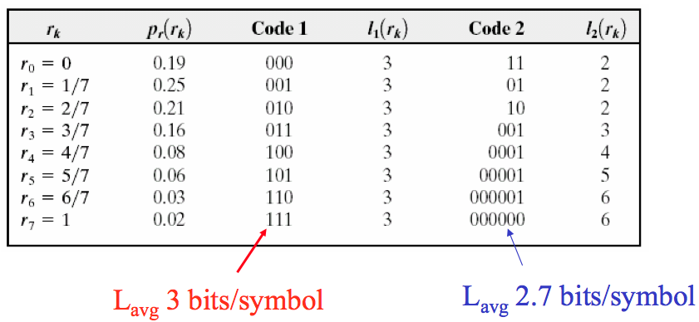
Coding Redundancy

Slide 10
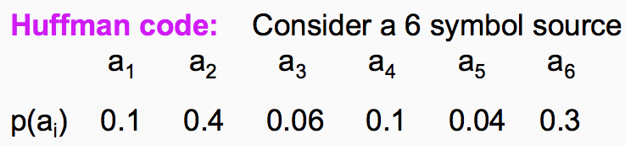
Huffman coding

Slide 11
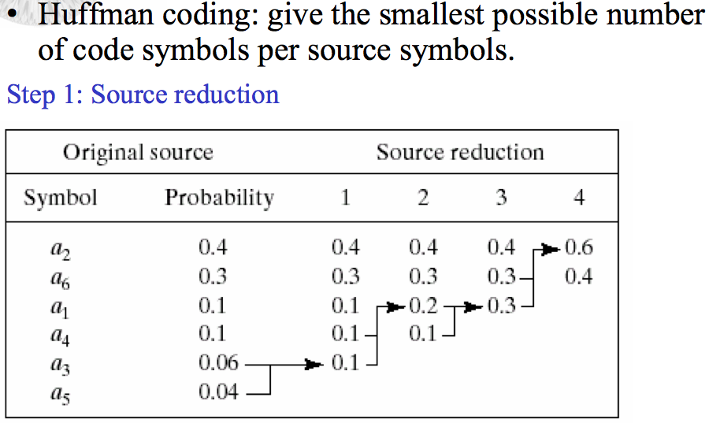
Huffman coding

Slide 12
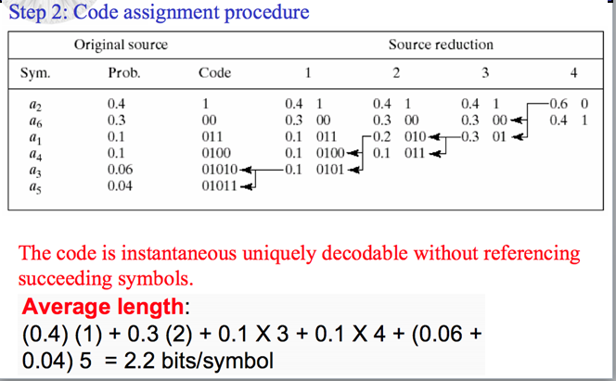
Huffman coding

Slide 13
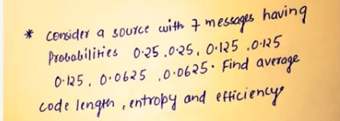
Huffman coding

Slide 14
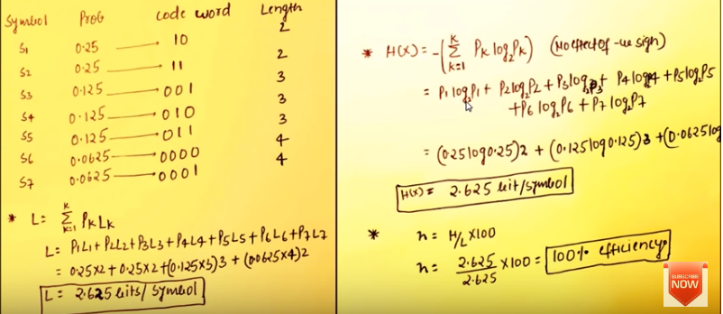
Huffman coding

Slide 15
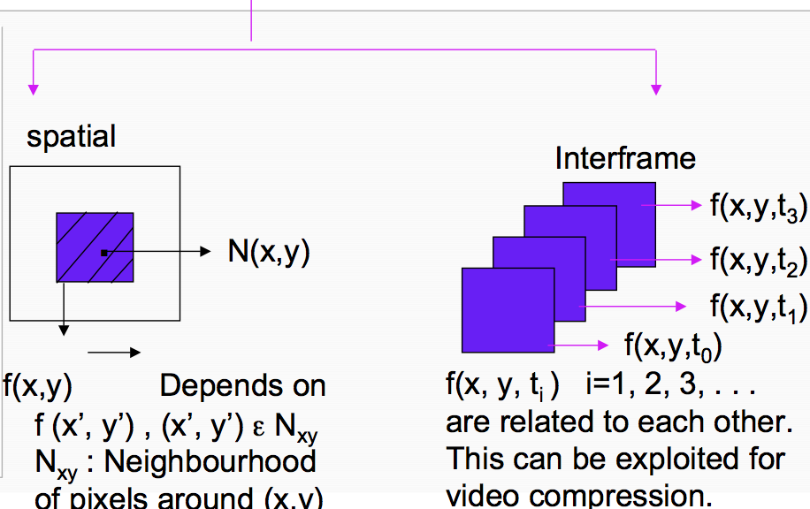
Interpixel / Interframe Redundancy

Slide 16
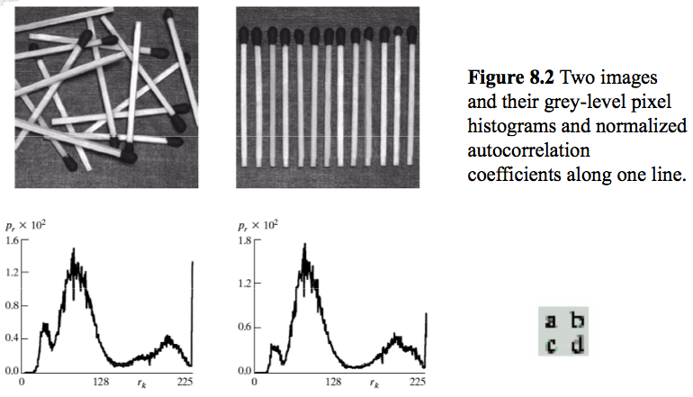
Interpixel / Interframe Redundancy

Slide 17
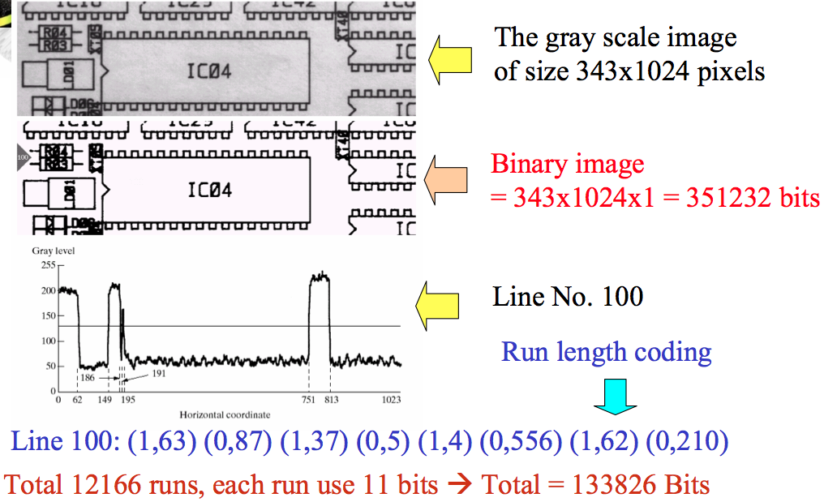
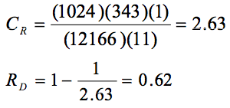
Run Length Coding

Slide 18
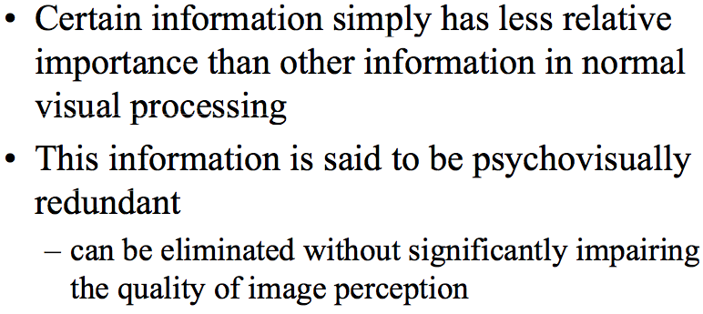
Psychovisual Redundancy

Slide 19
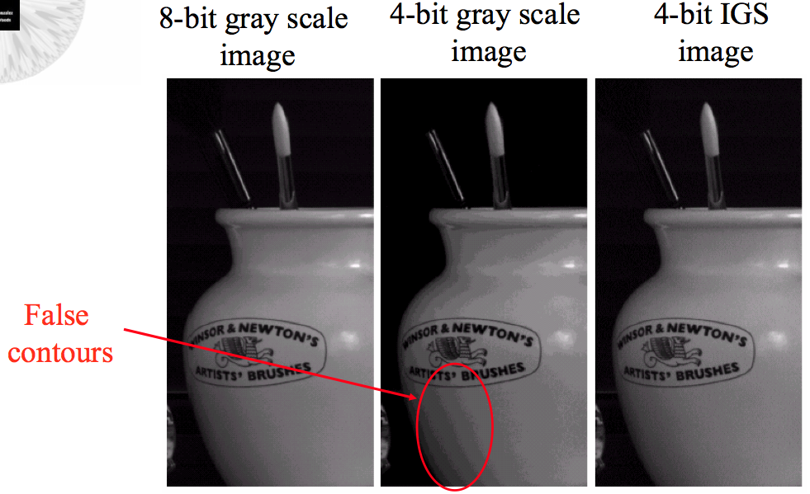
Psychovisual Redundancy

Slide 20
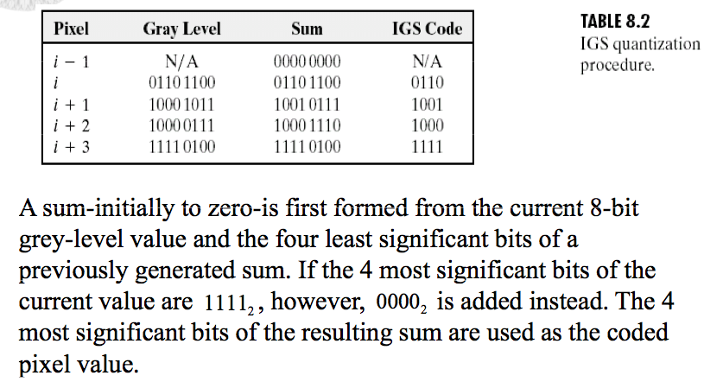
Psychovisual Redundancy

Slide 21
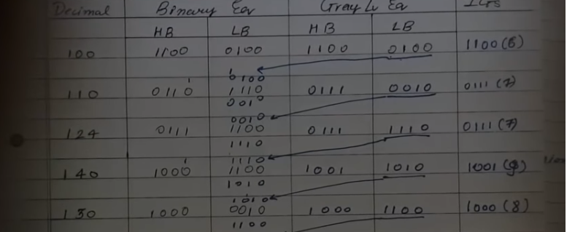
Psychovisual Redundancy

Slide 22
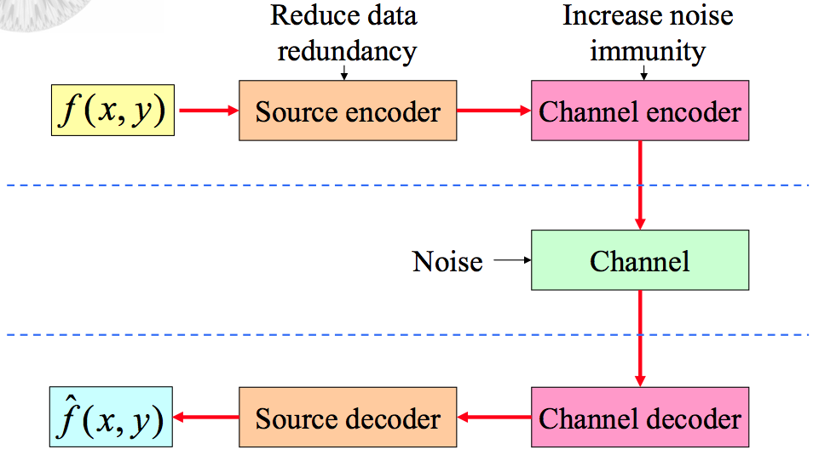
Image Compression Models

Slide 23
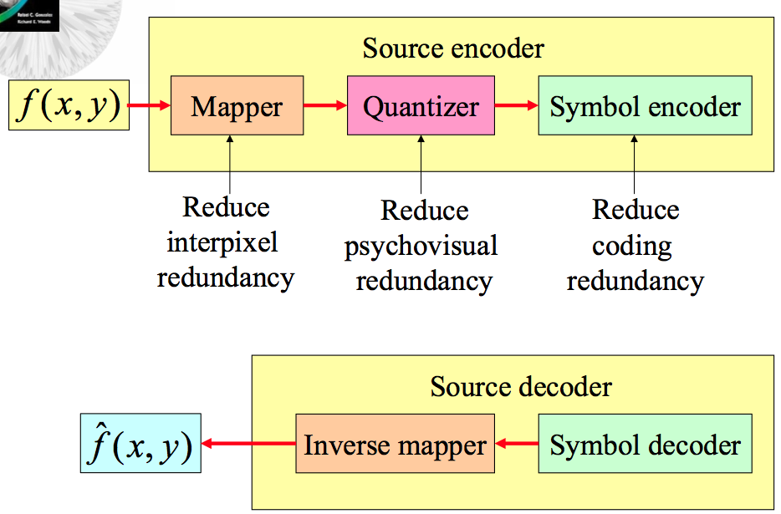
Source Encoder and Decoder Models

Slide 24
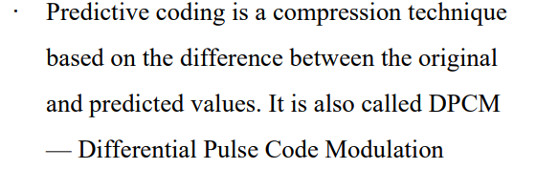
Predictive Coding

Slide 25
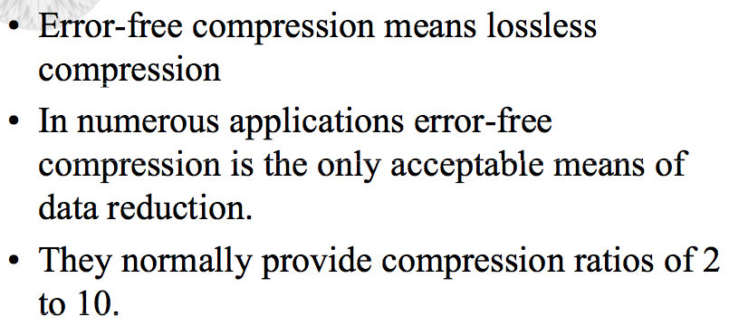
Error-Free Compression (Lossless)

Slide 26
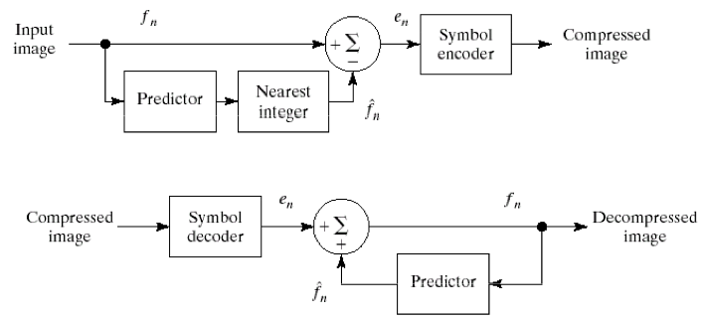
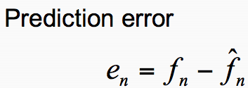
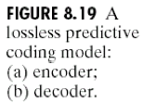
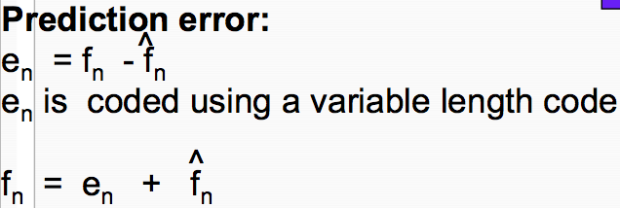
Lossless Predictive Coding Model

Slide 27
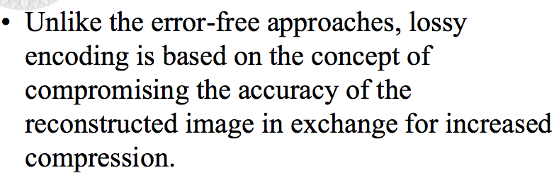
Lossy Compression

Slide 28
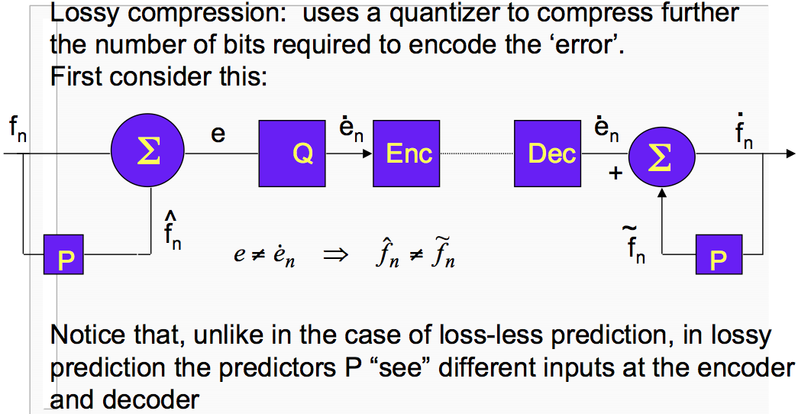
Lossy Predictive Coding : Feed forward

Slide 29
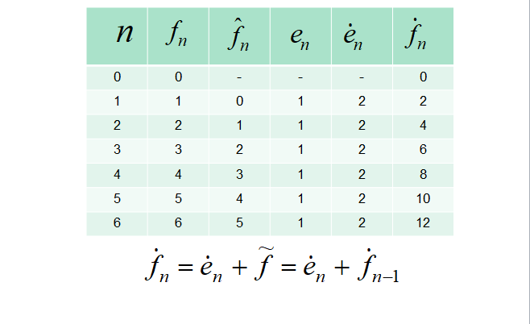
Lossy Predictive Coding : Feed forward

Slide 30
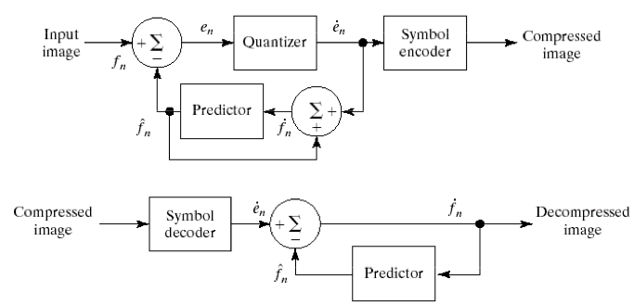
Lossy Predictive Coding : Feedback

Slide 31
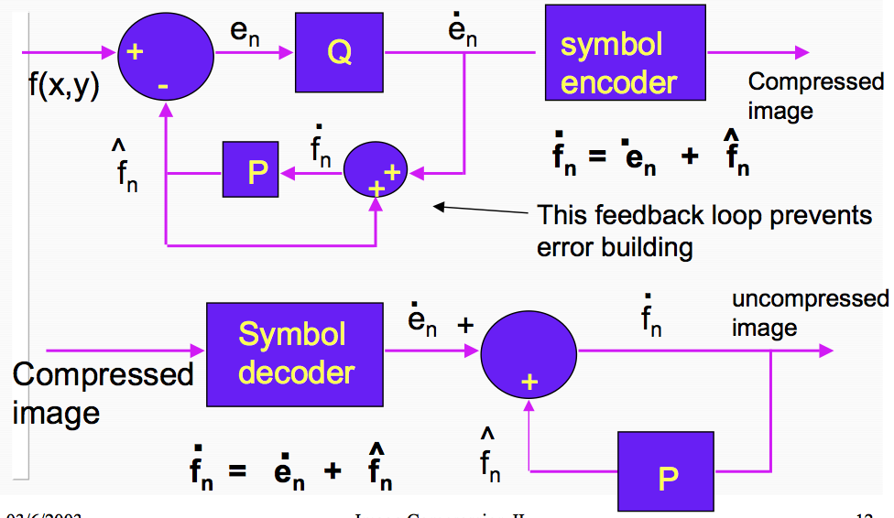
Lossy Predictive Coding : Feedback

Slide 32
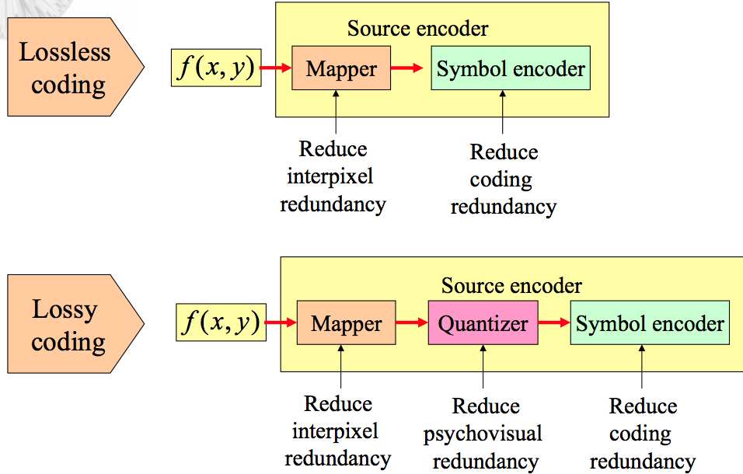
Lossless Vs. Lossy Coding

